Slide 1


Green Pace
Security Policy Presentation
Developer: Romain Tomlinson

Slide 2

OVERVIEW: DEFENSE IN DEPTH
Defense in Depth is a security strategy that employs multiple layers of defense to protect systems and data. This policy ensures that no single point of failure can compromise the entire system, making it more resilient against attacks. By integrating security practices throughout the development lifecycle, we can anticipate and mitigate threats before they materialize.

Slide 3
THREATS MATRIX
The Threats Matrix provides a structured overview of the identified coding vulnerabilities, categorized by their likelihood of occurrence and the priority of addressing them. By focusing on vulnerabilities with higher likelihood and priority, we can effectively allocate resources to mitigate the most significant risks. Automation tools will be used to detect these vulnerabilities early in the development process, allowing for immediate remediation and reducing the risk of exploitation.
Likely Threats that are very likely to happen | Priority Standards with High relevancy.
Low priority Standards with low relevancy. | Unlikely Threats that are not likely to happen.

Slide 4
10 PRINCIPLES
1. Validate Input Data: Improper input Validation (STD-003-CPP).
2. Heed Compiler Warnings: Buffer Overflow (STD-007-CPP), Memory Leak (STD-005-CPP)
3. Architect and Design for Security Policies: SQL Injection (STD-004-CPP), Race Condition (STD-008-CPP)
4. Keep It Simple: Code Complexity (STD-002-CPP)
5. Default Deny: Unauthorized Access (STD-009-CPP)
6. Adhere to the Principle of Least Privilege: Access Control (STD-010-CPP)
7. Sanitize Data sent to other systems: SQL Injection (STD-004-CPP)
8. Practice Defense in Depth: All standards.
9. Use Effective Quality Assurance Techniques: All Standards.
10. Adopt a Secure Coding Standard: All Standards.
These 10 principles form the foundation of our security policy. Each principle is associated with specific coding standards, ensuring that our policy is both comprehensive and aligned with best practices. By adhering to these principles, we can effectively reduce the risk of security breaches and maintain a high standard of code quality.

Slide 5
CODING STANDARDS
List of Coding Standards:
STD-004-CPP: SQL Injection (Critical Priority)
STD-003-CPP: Improper Input Validation (High Priority)
STD-007-CPP: Buffer Overflow (High Priority)
STD-008-CPP: Race Condition (Medium Priority)
STD-005-CPP: Memory Leak (Medium Priority)
STD-010-CPP: Access Control (Medium Priority)
STD-009-CPP: Unauthorized Access (Low Priority)
STD-002-CPP: Code Complexity (Low Priority)
STD-006-CPP: Use of Uninitialized Variables (Low Priority)
STD-001-CPP: Error Handling (Low Priority)
The coding standards have been prioritized based on their potential impact on system security and the likelihood of exploitation. Standards addressing SQL Injection and Improper Input Validation are given the highest priority due to their critical role in preventing unauthorized access and data breaches. Standards that mitigate less likely or less impactful vulnerabilities are given lower priority, but still remain essential for maintaining overall code quality and security.

Slide 6
ENCRYPTION POLICIES
Encryption in Flight:
All data transmitted across networks must be encrypted using secure protocols like TLS to prevent interception and unauthorized access during transmission.
Encryption at Rest:
Sensitive data stored on disk, such as databases and files, must be encrypted using industry-standard encryption algorithms (e.g., AES-256) to protect against unauthorized access.
Encryption in Use:
Data being processed by applications must be encrypted when it is loaded into memory, especially in multi-tenant environments, to prevent unauthorized access during processing.
These encryption policies ensure that sensitive data is protected at all stages of its lifecycle—during transmission, storage, and processing. By enforcing these policies, we can safeguard against potential data breaches and unauthorized access.

Slide 7
TRIPLE-A POLICIES
Authentication:
Enforce strong, multi-factor authentication (MFA) to verify user identities before granting access to systems and data.
Authorization:
Implement role-based access control (RBAC) to ensure users can only access the resources necessary for their roles, minimizing the risk of unauthorized access.
Accounting:
Maintain detailed logs of user activities, including login attempts and data access events, to support auditing and incident response efforts.
The Triple-A framework—Authentication, Authorization, and Accounting—ensures that only authorized users have access to resources, and their actions are monitored and recorded for security and compliance purposes. This framework is critical for maintaining control over who accesses sensitive data and how that data is used.

Slide 8
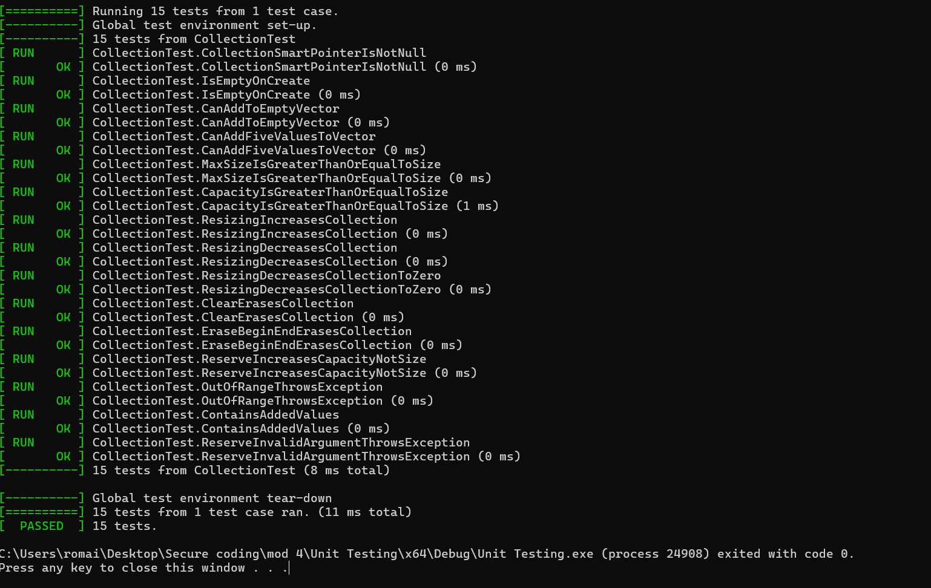
Unit Testing
Test 1: Is the Smart Pointer Not Null?
Vulnerability Tested: Ensuring that the smart pointer is correctly initialized and not null.
Test Case:
Positive Test: Check that the smart pointer is not null immediately after initialization.
Negative Test: This might involve a scenario where the smart pointer could become null unintentionally and verifying that the test detects this condition.
Results:
Expected: The smart pointer should not be null. The test should pass if the smart pointer is valid.
Actual: As shown in the image, the test passed with 0 ms execution time.

Slide 9
Unit Testing
Test 2: Can the Collection Add a Single Element?
Vulnerability Tested: Ensuring that elements can be added to the collection correctly.
Test Case:
Positive Test: Attempt to add one element to an empty collection.
Negative Test: Attempt to add an element to a collection that is somehow in an invalid state (e.g., memory corruption).
Results:
Expected: The collection should have one element after the addition.
Actual: The test passed, confirming that elements can be added correctly.

Slide 10
Unit Testing
Test 3: Can the Collection Resize Appropriately?
Vulnerability Tested: Ensuring that the collection resizes both up and down correctly.
Test Case:
Positive Test: Increase and then decrease the size of the collection.
Negative Test: Attempt to resize the collection to a size that exceeds its capacity or reduces it to a negative size.
Results:
Expected: The collection should adjust its size correctly without errors.
Actual: The test passed, confirming that the collection resizes as expected.

Slide 11
Unit Testing
Test 4: Does the Collection Handle Invalid Arguments Gracefully?
Vulnerability Tested: Ensuring that the collection throws exceptions or handles errors when invalid arguments are passed.
Test Case:
Positive Test: Call a method with valid arguments and check that it performs as expected.
Negative Test: Pass an invalid argument (e.g., a negative index) and ensure that the collection throws an appropriate exception.
Results:
Expected: The test should detect invalid arguments and handle them correctly.
Actual: The test passed, confirming that exceptions are handled properly.

Slide 12

AUTOMATION SUMMARY

Slide 13
TOOLS
DevSecOps integrates security into every stage of the development lifecycle, ensuring security is a shared responsibility:
Assess & Plan: Analyze threats, prioritize security tasks.
Design: Implement security-driven design with OWASP best practices.
Build: Secure builds using trusted repositories and automated security checks.
Verify & Test: Use SAST, DAST, and IAST tools to identify vulnerabilities.
Transition & Health Check: Apply security settings and perform penetration testing before deployment.
Monitor & Detect: Continuous monitoring with SIEM and IDS tools to detect threats.
Respond: Automate response to incidents, rollback if needed.
Maintain & Stabilize: Regularly assess and ensure the system remains secure.
External Tools:
SAST/DAST: SonarQube, OWASP ZAP for code and application testing.
Penetration Testing: Metasploit for in-depth security validation.
SIEM: Splunk for continuous monitoring and threat detection.

Slide 14
RISKS AND BENEFITS
Problems Identified:
Lack of Early Security Integration: Security is often addressed too late in the development process, increasing the risk of vulnerabilities going undetected until after deployment.
Inconsistent Security Practices: Variability in security practices among team members can lead to gaps in protection, leaving the system vulnerable to attacks.
Complexity in Legacy Systems: Older systems may lack the architectural flexibility to integrate modern security practices, posing a significant challenge.
Solutions Proposed:
Early Security Integration: Implement security measures from the beginning of the development lifecycle (Shift Left Security), ensuring vulnerabilities are identified and mitigated early.
Standardization of Security Practices: Develop and enforce a unified set of security guidelines that all team members follow, reducing the likelihood of inconsistencies.
Legacy System Updates: Gradually refactor and modernize legacy systems to support current security standards, reducing their vulnerability to modern threats.

Slide 15
RISKS AND BENEFITS
Act Now:
Benefits: Reduces the risk of data breaches, enhances compliance, and strengthens overall system integrity. Immediate action can prevent costly security incidents and improve customer trust.
Risks: Initial costs may be higher due to the need for additional resources, training, and potential delays in development timelines.
Wait:
Risks: Delaying security measures increases the risk of exploitation, leading to potentially catastrophic breaches, legal consequences, and reputational damage.
Benefits: Short-term cost savings, but at the expense of long-term security and compliance.
Strategy Analysis:
Lacking Aspects: The current strategy may not fully address the challenges of integrating security into legacy systems or the need for continuous security updates in rapidly evolving threat landscapes.
Risks of the Current Strategy: Without timely updates, legacy systems remain vulnerable. Additionally, inconsistent security practices could lead to gaps that attackers can exploit.
Recommended Steps:
Prioritize the modernization of legacy systems.
Implement continuous security training and updates.
Ensure regular audits and reviews to maintain the effectiveness of the security strategy.

Slide 16
RECOMMENDATIONS
Gap Analysis: The current security policy covers many critical areas but still has gaps, such as insufficient focus on secure coding practices in legacy systems. These gaps should be addressed to ensure comprehensive coverage.
Standards to Adapt: Adopt additional standards focused on secure coding, such as SEI CERT guidelines, to prevent future vulnerabilities.

Slide 17
CONCLUSIONS
In conclusion, the Green Pace Security policy provides a robust framework for securing our applications. By implementing the recommendations and closing the identified gaps, we can continue to improve our security posture and protect against emerging threats.

Slide 18
REFERENCES
SEI CERT. (2021). SEI CERT C++ Coding Standard. Carnegie Mellon University Software Engineering Institute. Retrieved from https://www.sei.cmu.edu/education-outreach/cert-training/coding-standard/
National Institute of Standards and Technology (NIST). (2018). Recommendation for Key Management: Part 1 – General (Revision 5). Special Publication 800-57. Retrieved from https://nvlpubs.nist.gov/nistpubs/SpecialPublications/NIST.SP.800-57pt1r5.pdf
OWASP Foundation. (2021). OWASP Top Ten Security Risks 2021. Retrieved from https://owasp.org/Top10/
Microsoft. (2019). Microsoft Secure Development Lifecycle (SDL). Retrieved from https://www.microsoft.com/en-us/securityengineering/sdl/
National Institute of Standards and Technology (NIST). (2018). Framework for Improving Critical Infrastructure Cybersecurity. Version 1.1. Retrieved from https://nvlpubs.nist.gov/nistpubs/CSWP/NIST.CSWP.04162018.pdf

